Slide 1
Elementary data structures

Slide 2
Elementary data structures
Stacks and queues
Linked Lists
Rooted trees

Slide 3
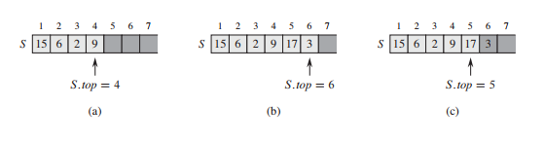
Stacks
In a stack, the element deleted from the set is the one most recently inserted: the stack implements a last-in, first-out,
or LIFO, policy.

Slide 4
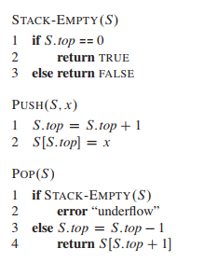
Stacks

Slide 5
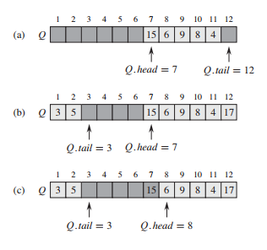
Queue
in a queue, the element deleted is always the one that has been in the set for the longest time: the queue implements a first-in, first-out, or FIFO, policy.

Slide 6
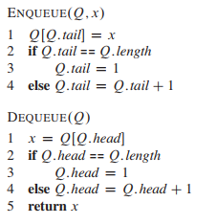
Queue

Slide 7
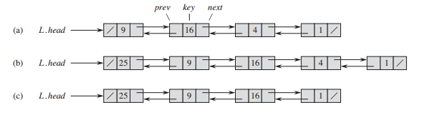
Linked list
A linked list is a data structure in which the objects are arranged in a linear order. Unlike an array, however, in which the linear order is determined by the array
indices, the order in a linked list is determined by a pointer in each object.

Slide 8
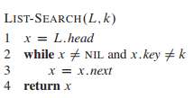
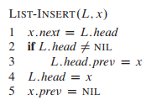
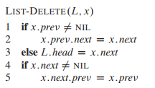
Linked list methods

Slide 9
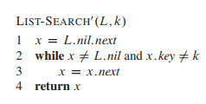
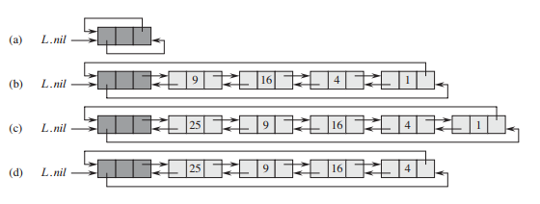
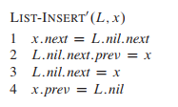
Using sentinels in a linked list

Slide 10
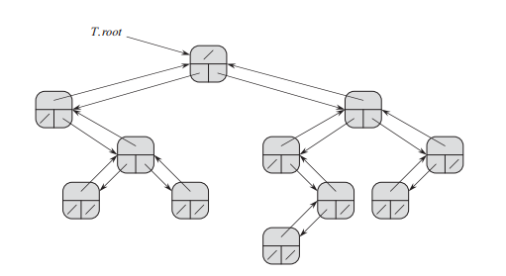
Rooted tree
We represent each node of a tree by an object. As with linked lists, we assume that each node contains a key attribute. The remaining attributes of interest are
pointers to other nodes, and they vary according to the type of tree.

